Slide 1





Slide 2



In the beginning ....

Slide 3
Mission
The Hendricks County Youth Assistance Program (HCYAP) serves as a voluntary early intervention & advocacy process for at-risk youth and families. HCYAP engages the community holistically and brings together individuals, faith-based, and other non-profit organizations to provide support, enrichment and opportunities for youth and their parents and caregivers.

Slide 4




HCYAP
    Plainfield YAP took their first referral in February 2021
    Avon YAP started in August 2024

Slide 5


    at risk of becoming involved in the juvenile system
Students referred to HCYAP
    poor or declining grades or attendance
    risk of dropping out of school or being suspended/expelled
    Mental Health concerns (parent or child)
    Loss of parent or caregiver
    experienced domestic violence or other trauma

Slide 6

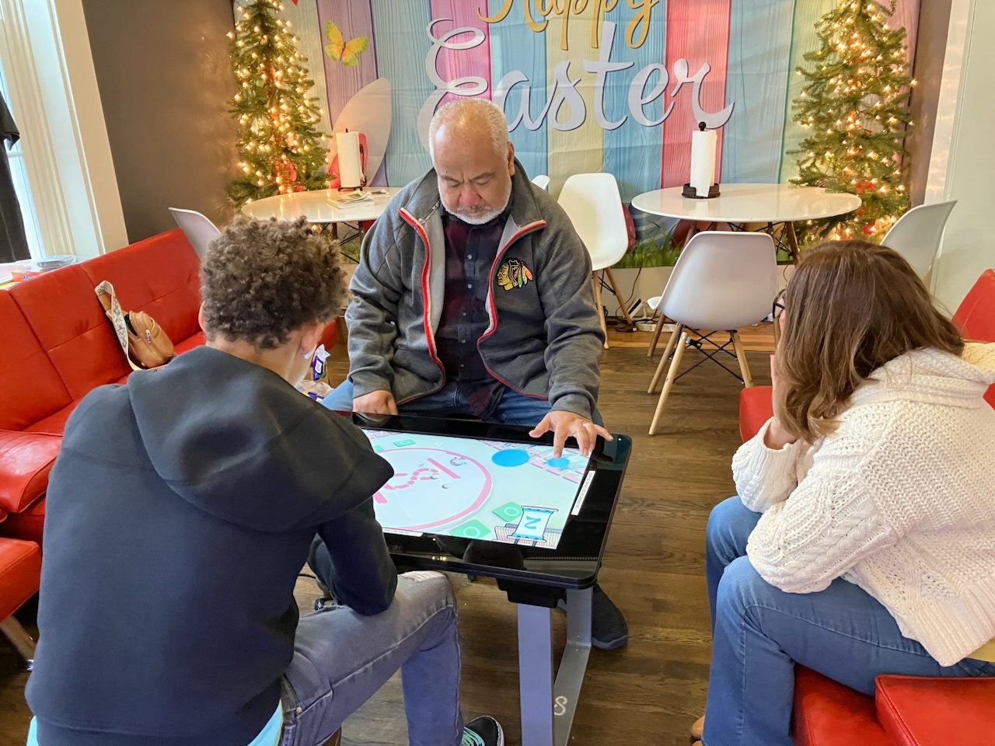
Program Plan
    Referral
    Intake & Assessment
    Individualized Action Plan
    Case Management

Slide 7
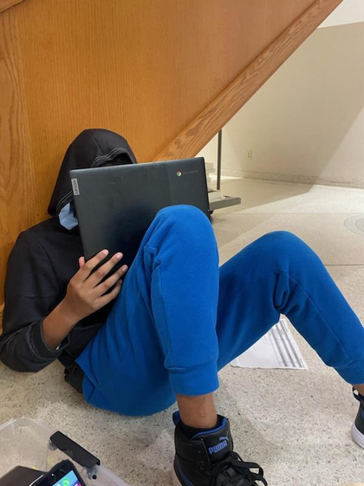
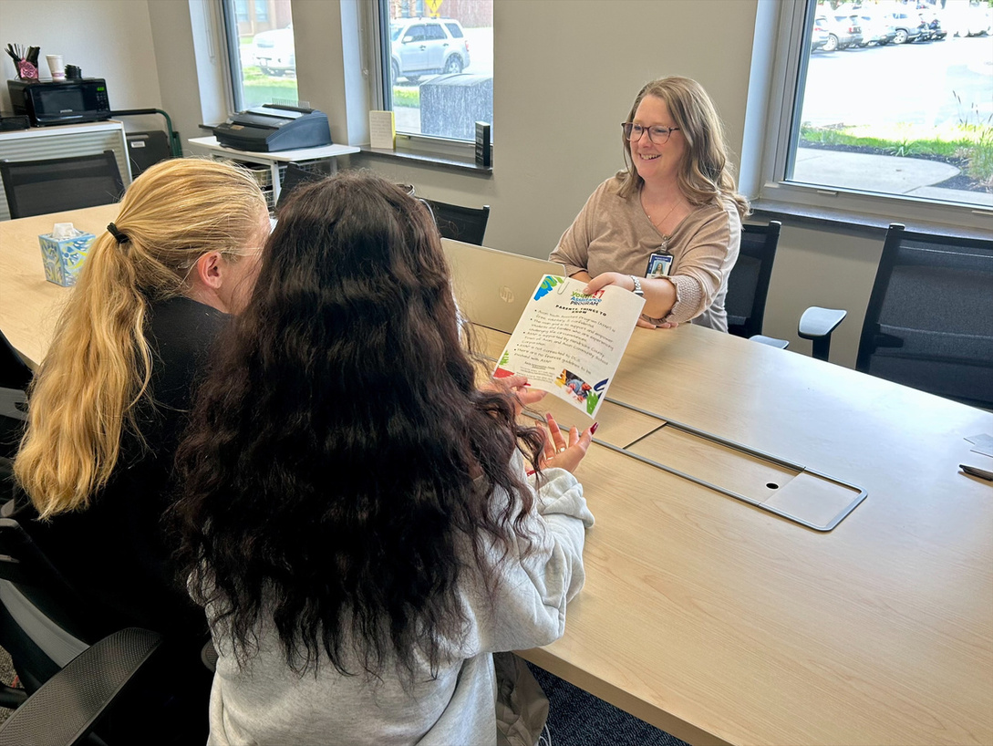
3 Initiatives
    Tutoring
    Mentoring
    Full Family Program

Slide 8

























Community Programming

Slide 9
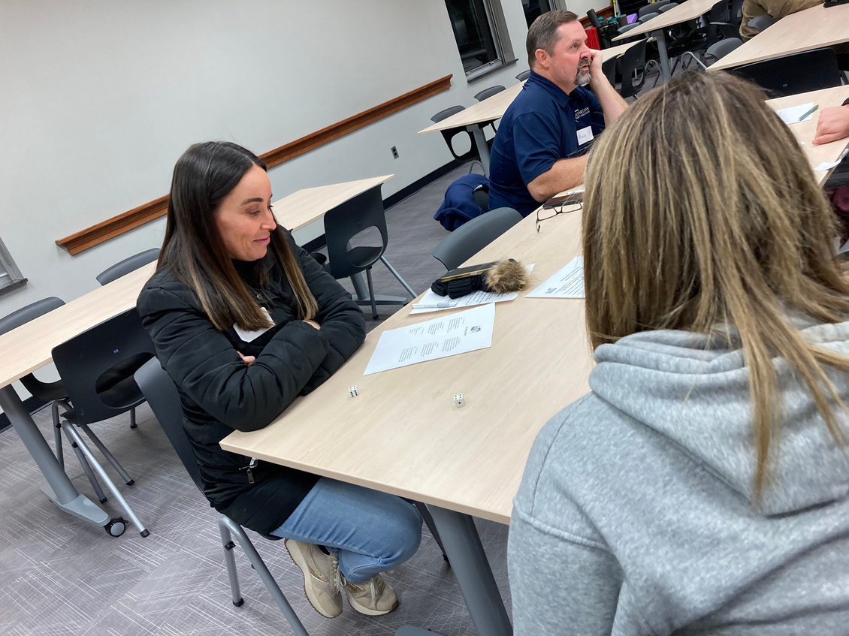
    In 2024-25 school year, 78% of students in Avon YAP were in good standings with grades
    1 student in Avon YAP showed 12% growth since getting a mentor!
    In 2025, started working with Project Attend referrals
    since Plainfield YAP, there has been a 30% decrease with Plainfield students referred to probation
Some Highlights

Slide 10
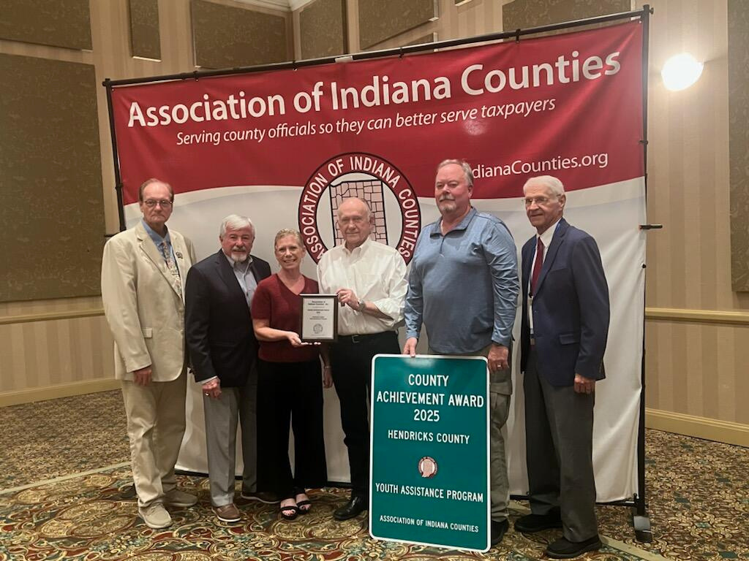
2025 County Achievement Award

Slide 11

Questions?

